Slide 1
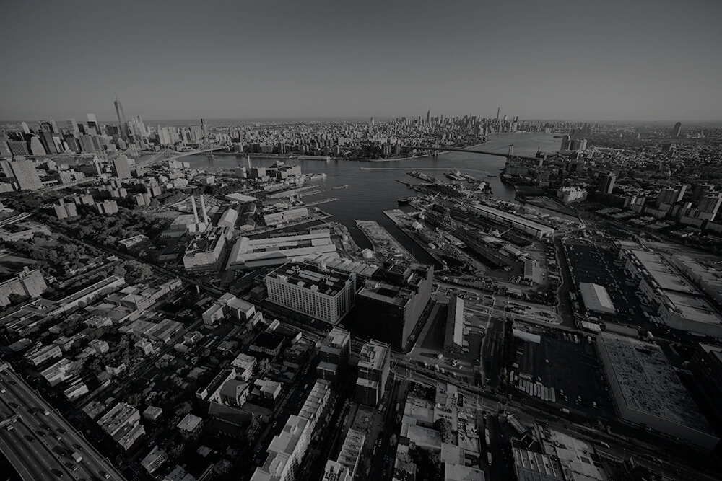
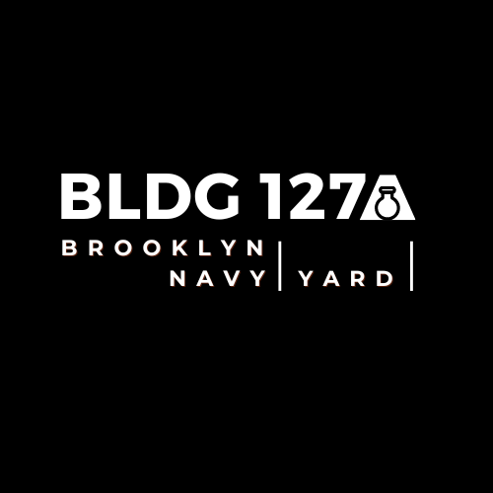

Leo Weiner | Mark Levy | Corey Satnick | Jasmine Hall | Colin Dallas-WU

Slide 2
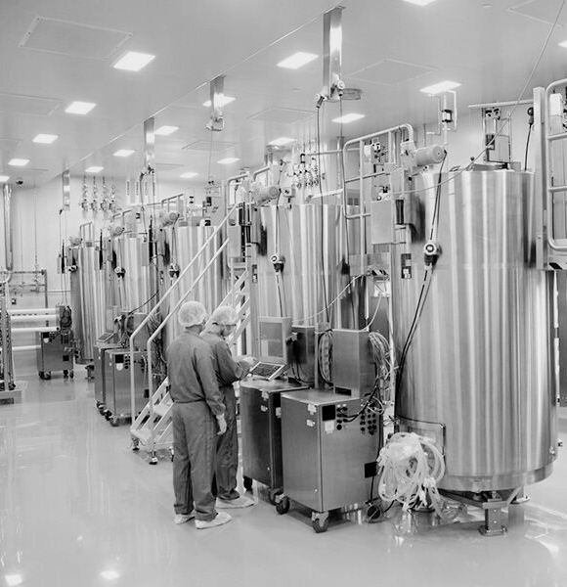
Executive Summary
Demographic Overview
Market Analysis
Site Overview
Zoning
Design & Rendering
Incentives in the Yard
Building Comps
Financial Overview
Risk & Mitigants

Slide 3
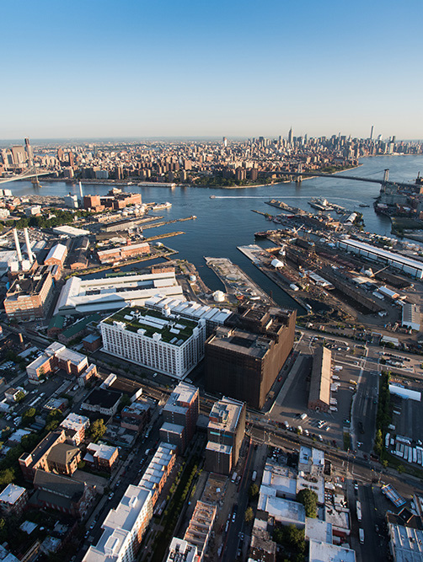
EXECUTIVE SUMMARY
BLDG 127A proposes the development of a landmark industrial building at site 127, located within the Brooklyn Navy Yard, through a ground lease agreement with New York City.
The project involves replacing a historic building with a sustainable, cutting-edge industrial facility, covering 90,000 square feet.
The goal is to secure 100% net leases for each floor of this state of the art building. Market analysis highlights strong supply-demand dynamics in the borough, despite subdued net absorption in the Navy Yard.
Supported by the area's demographic density and attractive local tax incentives, this venture presents a unique opportunity for substantial returns in one of America's most sought-after industrial markets.

Slide 4
DEMOGRAPHIC OVERVIEW
Notes:
General Market Trends: There's been an increase in average asking rents across all asset types compared to the previous quarter. However, Class A industrial properties' asking price has remained steady at an average of $28.90.
Brooklyn's Market Dynamics: In Brooklyn, industrial asking rents have risen notably by 16.8% from the previous quarter and 14% year-over-year, reaching an average of $27.58. Although specific data for Class A industrial properties in Brooklyn is unavailable, this growth strongly suggests a market ripe for demand.
Construction and Development in NYC: Currently, New York City has 13 properties under construction (5.6 million sq. ft.) with a 48.3% pre-lease rate. Additionally, 17 properties (4.8 million sq. ft.) are planned or proposed. Significantly, Brooklyn accounts for a substantial portion of this development, both ongoing and planned, indicating a growing supply to meet increasing demand.
Brooklyn Leading in Industrial Leasing: Despite a downturn in industrial leasing in NYC overall, Brooklyn emerges as a leader. It recorded the highest leasing velocity of any borough with nearly 320,000 sq ft leased this quarter, amounting to 61% of the city's total leased industrial space. Brooklyn also witnessed the largest lease transactions, further underscoring its market demand.
Vacancy Rates and Net Absorption: While the city-wide net absorption has seen a decline and the class A vacancy rate has fallen, a closer look reveals that these changes are primarily outside Brooklyn. In Brooklyn, vacancy rates have remained relatively stable, and there have been positive net absorptions in specific areas like Sunset Park/Greenwood and Williamsburg/Greenpoint. The Navy Yard's negative net absorption could indicate a market recalibration, presenting new opportunities for tenant occupancy and space repurposing.
Opportunity in the Navy Yard: The Navy Yard's current state, with its negative net absorption, might be viewed as a strategic opportunity. The consistent demand in Brooklyn and the overall decrease in Class A vacancy rates in NYC to 3.6% reflect a healthy market. The Navy Yard's position may open doors for new tenants or for redeveloping existing spaces to better align with evolving market needs and trends.

Slide 5






Demographic & Statistics
$107,630
>
$72,150
49%
Median Household Income of Brooklyn
Median Household Income of NYC
34.6
75%
10.95%
Car-free commute (% of commuters)
Unemployment rate
Mean travel time to work
Serious crime rate
14.1 per 1,000 residents in Brooklyn
14.2 per 1,000 residents in NYC
Density
Year
2006
2010
2019
2021
34.3
35.5
36.7
38.7
Population Density (1,000 persons per sqaure mile)

Slide 6
MARKET ANALYSIS

Slide 7
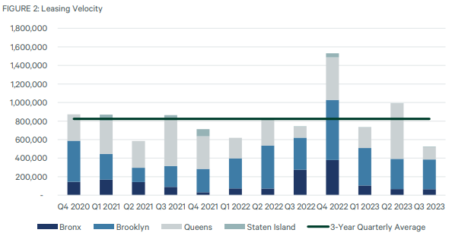

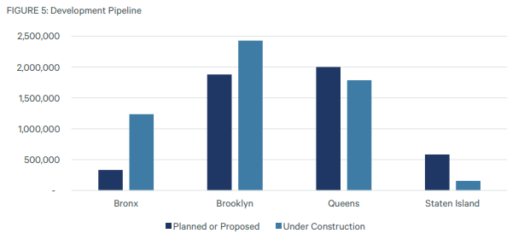
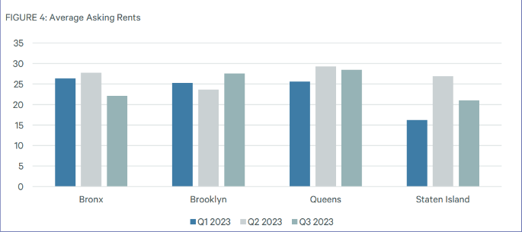
MARKET
UPDATE
Vacancy Rate: Decreased to 5.5%.
Net Absorption: Positive increase, reaching 487,000 sq. ft.
Class A Rent: Maintained at $28.90 per sq. ft.
Leasing Velocity: Dropped 36.3% below the three-year average.
Under Construction: 13 properties, totaling 5.6 million sq. ft.
Future Development: 17 planned/proposed properties, 4.8 million sq. ft.

Slide 8
SITE OVERVIEW

Slide 9
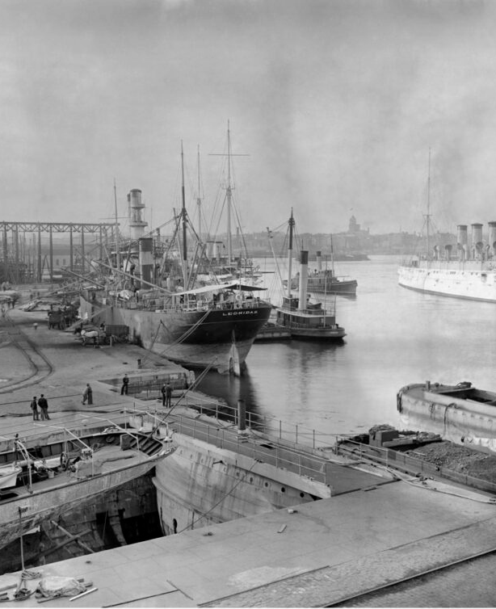
Brooklyn Navy Yard Overview:
Historical Significance:
Founded in 1801; a primary U.S. Navy shipbuilding center for 165 years.
Birthplace of significant warships: USS Monitor, USS Arizona, USS Missouri.
Peak during World War II, employing 70,000 workers.
Strategic Location
Situated along Brooklyn’s waterfront, Southeast of Manhattan.
Close proximity to ferry, subway, and bus routes.
Near Williamsburg and Greenpoint, Brooklyn.
Undergone Modern Transformation and Usage over the last few decades
Spanning 300 acres with 500+ businesses, employing over 11,000 people.
Annual economic contribution: Over $2.5 billion.
Growing demand for industrial lofts and flexible office spaces.

Slide 10
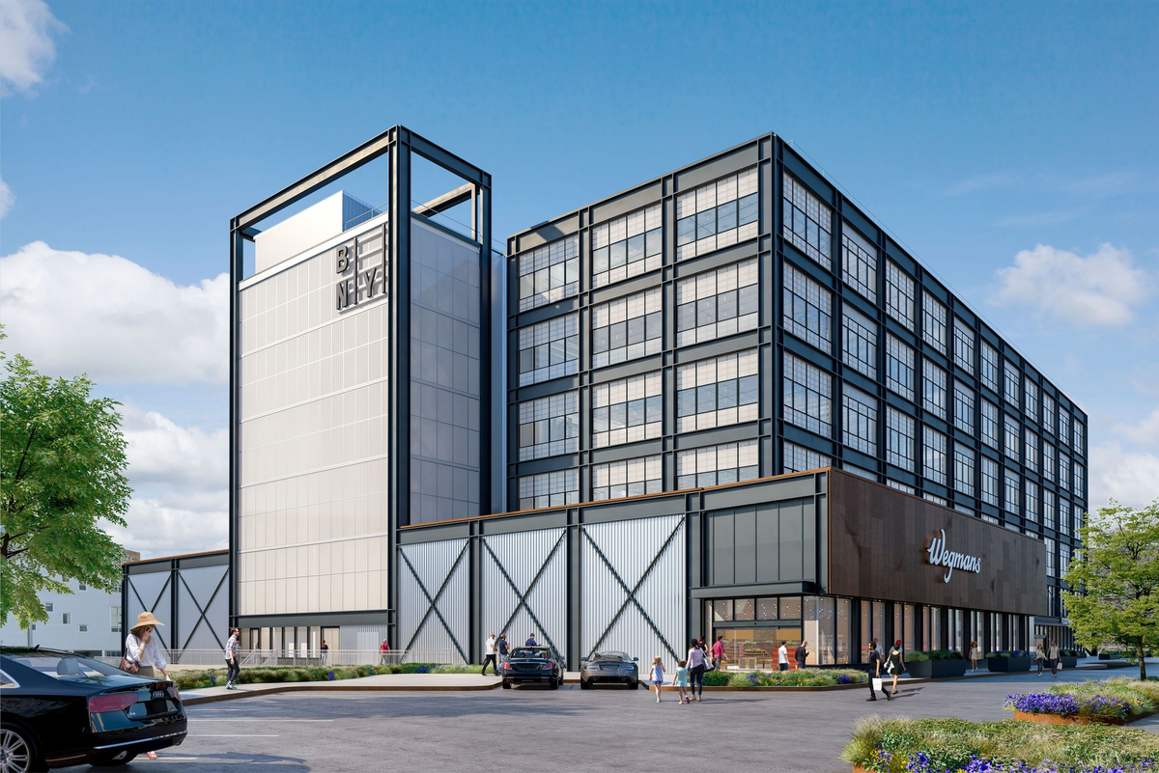
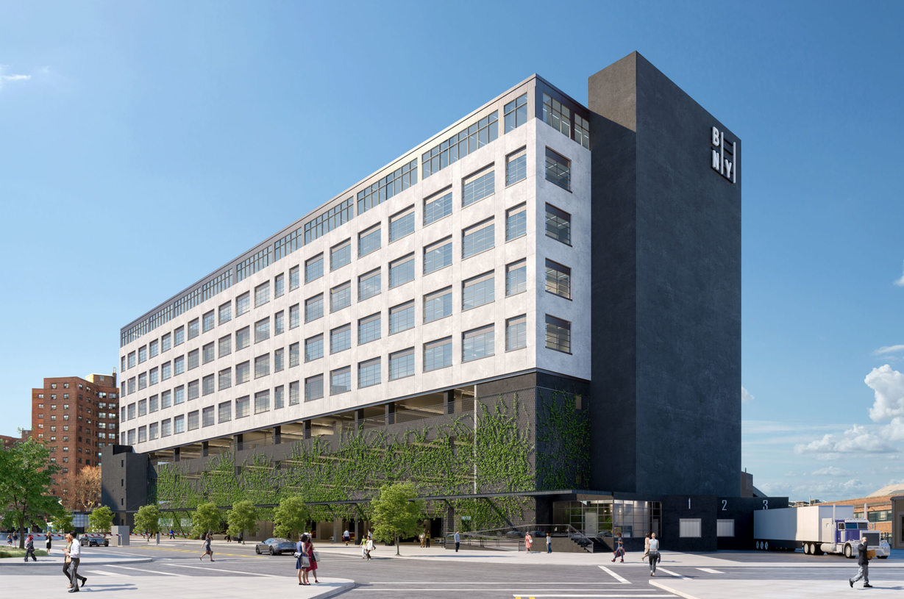
Key Development and Future Outlook
Key Developments
Building 212: 96,000 sq ft light industrial, 34,000 sq ft office space.
Home to Wegmans; considered a cornerstone of the Navy Yard.
Building 303: 160,000 sq ft industrial, 50,000 sq ft office space.
Five floors with views of Manhattan and Brooklyn.
Future Outlook
Ongoing redevelopment and growth.
Increasing interest from diverse companies and industries.
Tax Incentives from the government to clean up the yard

Slide 11
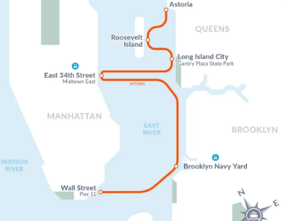
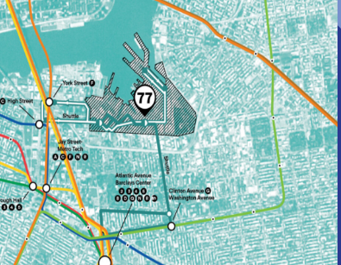


Ferry and Subway Systems

Slide 12
ZONING

Slide 13
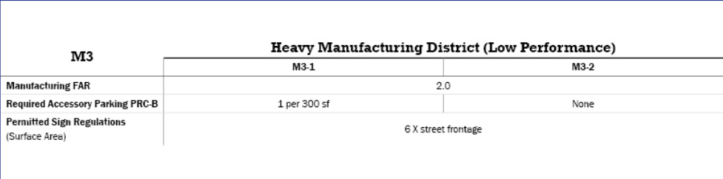
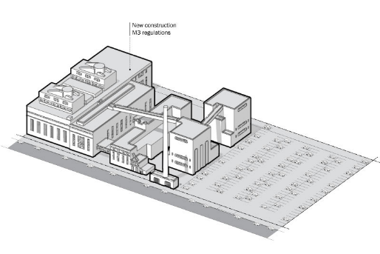
2.0
Maximum FAR (Floor Area Ratio)
60 feet
Maximum base height before setback

Slide 14
DESIGN & RENDERING

Slide 15

Building Design
95,000 square feet build-out
4 floors, 6 tenant capacity
Floor-to-ceiling windows, reinforced by steel panels to mitigate severe weather conditions
Ventilated solar screens are installed above the windows to regulate the building’s internal temperature.
Solar panels are installed on the roof to provide renewable energy to the building’s machinery and systems.
Gardens will be planted along the perimeter of the roof and terraces to extend the longevity of the building during storms.
A parking garage is built on an incline above sea level with a reservoir for the drainage of rainwater back into the ground.

Slide 16
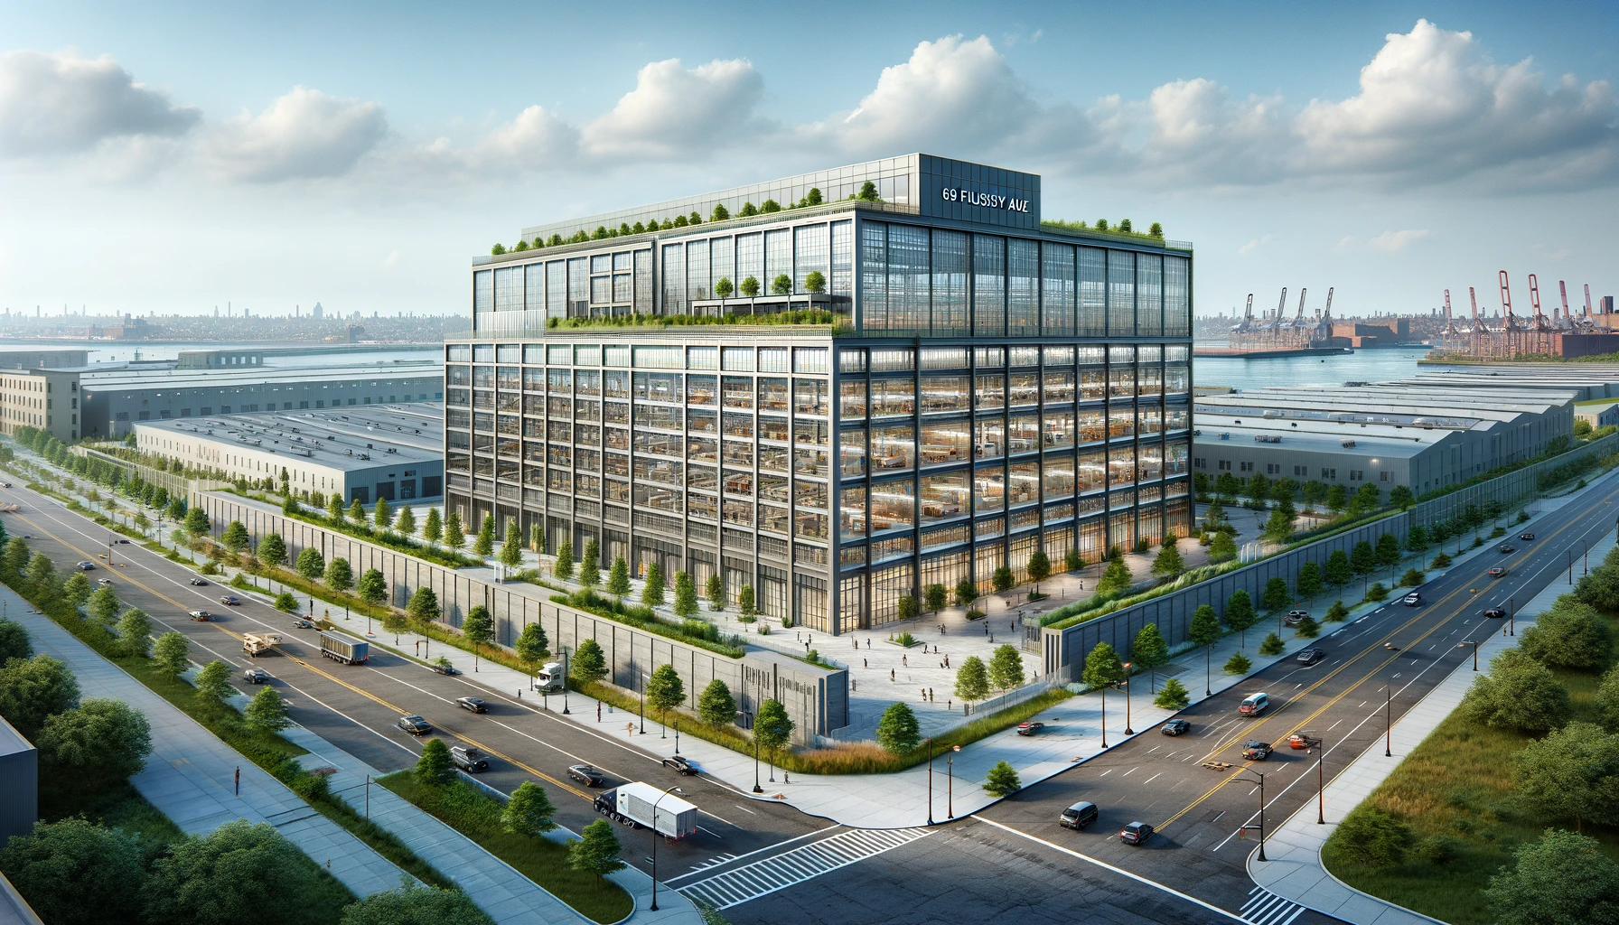
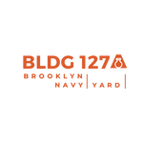



Slide 17
BUILDING COMPS

Slide 18
222 44th St. Brooklyn, NY (LoopNet)
Price: $17,000,000
Price per SF: $425
Property Type: Industrial
Rentable Building Area: 40,000 SF
Parking Ratio: 0.05/1,000sf
Building Class: B
Year Built: 1918
4401-4423 Second Ave. Brooklyn,
NY (LoopNet)
Price: $25,000,000
Price per SF: $417
Property Type: Industrial
Rentable Building Area: 60,000 SF
Building Class: B
Year Built: 1913
Averages:
Price: $135,750,000
Price per SF: $490.50
Rentable Building Area: 43,400 SF
1182 Flushing Ave. Brooklyn NY (LoopNet)
Price: $12,500,000
Price per SF: $287
Property Type: Industrial
Rentable Building Area: 43,600 SF
Cap Rate: 7.26%
Building Class: C
Year Built: 1931
58 Kent St Brooklyn, NY (LoopNet)
Price: $325,000,000
Price per SF: $833
Property Type: Industrial
Rentable Building Area: 30,000 SF
Cap Rate: 6.87%
Building Class: A
Year Built: 1931

Slide 19
INCENTIVES IN THE YARD

Slide 20

Leasing Incentives
Opportunity Zone Benefits
Potential tax deferral on capital gains from investments (Dec 31, 2017 - Dec 31, 2026).
Substantial tax benefits for capital improvements.
Exemption from Real Estate Taxes
Tenants pay no real estate taxes on City-owned property.
Relocation and Employment Assistance Program (REAP)
Income tax credits for businesses relocating jobs from outside NYC or below 96th Street in Manhattan.
Energy Cost Savings Program (ECSP)
Reduced regulated energy costs up to 45%.
Reduced regulated natural gas costs up to 35%.
Benefits duration: 12 years.

Slide 21
FINANICAL OVERVIEW

Slide 22





Loan Amount:
Request Summary
$21,553,125
Product Type:
Uses:
Construction to Permanent Loan Financing
The construction loan proceeds will be utilized in order to redevelop the site into an industrial, environmentally sustainable, and socially responsible design that will make the building into a trophy building.
A permanent loan will be utilized to assist in the financing of the property.
Term:
Construction: 2 Years I/O
Permanent: 10/25 term
Interest Rate:
Construction: 10%
Permanent: fixed rate of 5.75%
Pricing:
30-Day SOFR + 40bps
LTV:
69% based upon property value of $31,051,476

Slide 23
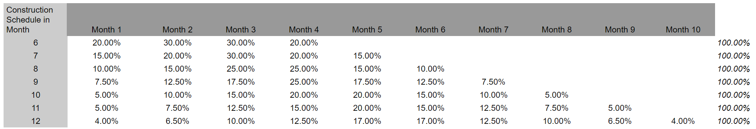
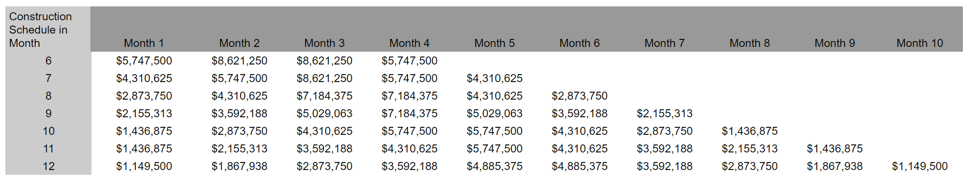
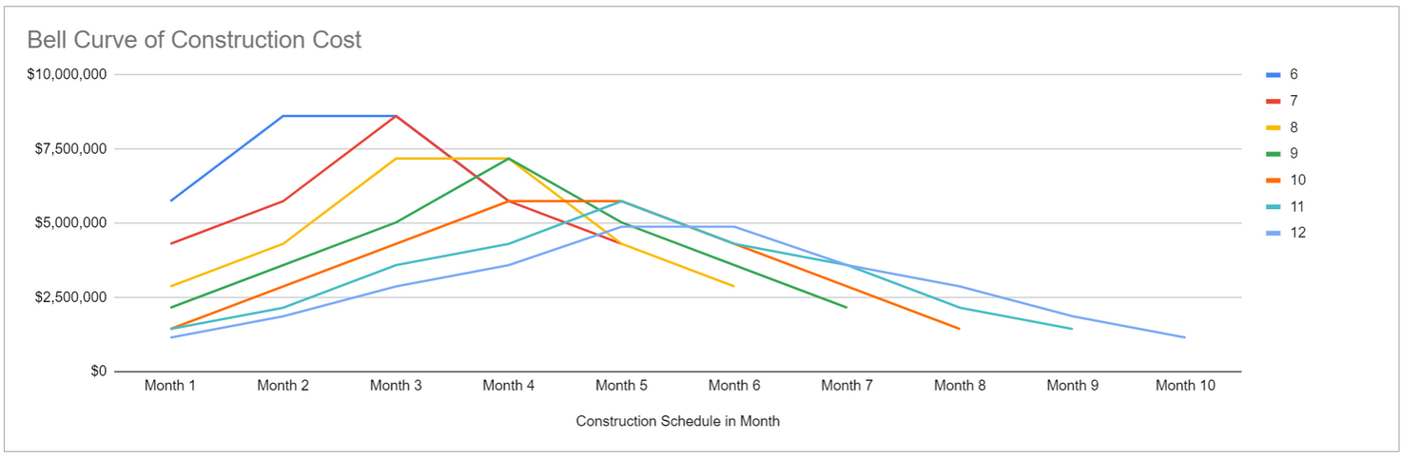
Construction Costs
= $28,7337,500

Slide 24
Underwriting Analysis
Rental Income: $3,511,200
Annual Increases: 4%
Additional Income: $92,634 for
Parking & Storage
Annual Increases 3%
Tenant Improvements: $1.5/SF
Vacancy/Credit Loss: 8% of EGI
Effective Gross Income: $3,180,438
Total Expenses: $1,006,834
Reimbursements: $816,009
Operating Expenses: 2% of EGI
Management Fee: 4% of EGI
Capital Reserves: 2% of EGI
Net Operating Income: $2,989,612

Slide 25
Cash Flow Analysis
Ground Lease Payments: $418,346, which was calculated by using year 1 NOI minus reimbursements divided by Cap Rate of 7%. Payment increases 2% every year.
Capital Expenditures: 2% of EGI $45,744
Hard Costs: $22,467,500
Soft Costs: $5,795,000
Demolition Costs: $475,000
Unlevered Cash Flow totals $1,657,927
Construction Loan Debt Service Payment: $2,155,313
Ammortization Debt Service Payment: $1,646,188
Levered Cash Flow totals $467,378
DSCR 1.39x
 | Unlevered | Levered
IRR | 15.54% | 23.47%
Investment | 29,185,113 | 9,787,301
Profit | 62,924,474 | 47,789,312

Slide 26
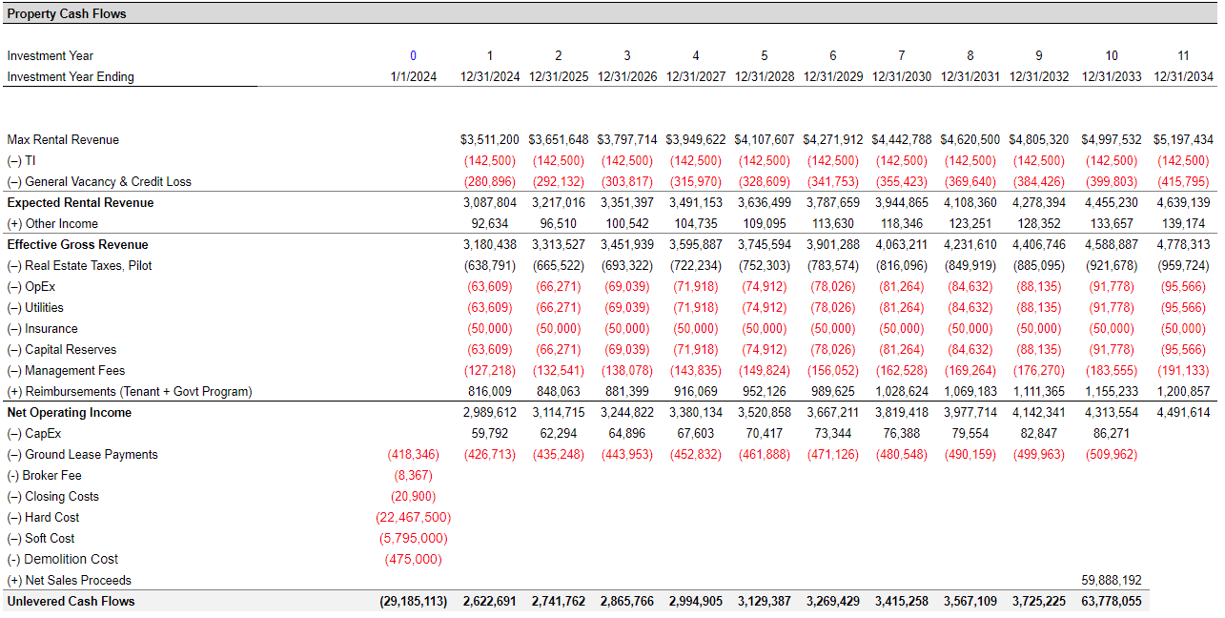
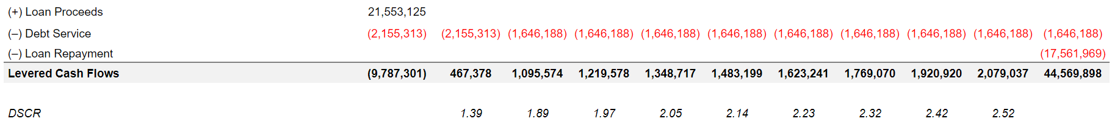

Slide 27
RISK & MITIGANTS

Slide 28
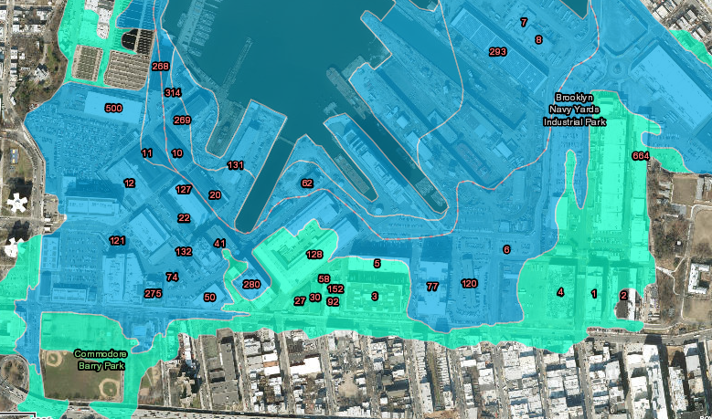

FLOOD RISK
NYC Flood Hazard Mapper Current Day
The cost of insurance, including flood insurance is $.53 psf.
Flood Zone AE
Present a 1% annual chance of flooding (opens in new window)
This will increase as time progresses.
Mitigating this by adding foundation and first floor BFE along with points mentioned in the design slide

Slide 29
DEVELOPMENT AND CONSTRUCTION RISK
Mitigant: Implement strict project management protocols and regular reviews.
Mitigant: Engage in effective resource allocation and contingency planning.
Risk: Permitting and Bureaucratic Delays
Mitigant: Establish strong relationships with city officials and regulatory bodies.
Mitigant: Hire experienced legal and compliance experts to navigate permitting processes.
Risk: Delay and Cost Overruns

Slide 30
FINANCING RISK
Mitigant: Regular market analysis to anticipate and adapt to changes.
Mitigant: Diversify investment to minimize impact of market volatility.
Risk: Fluctuating Market Conditions
Risk: Fluctuating Loan
Mitigant: Lock in fixed-rate financing options at well below the stabilized value of the property

Slide 31
THANK YOU!

